Slide 1
Jeopardy
Jordan Wang

Slide 2
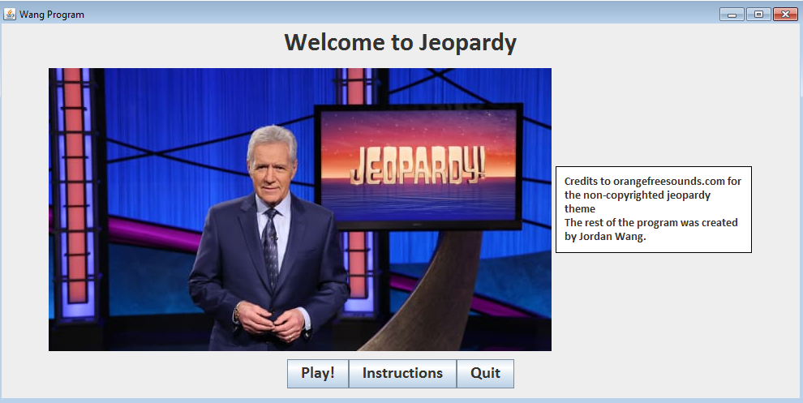
Objective
Create a game in which the knowledge of players are tested.
Familiarity with the user and easy to understand interface.

Slide 3
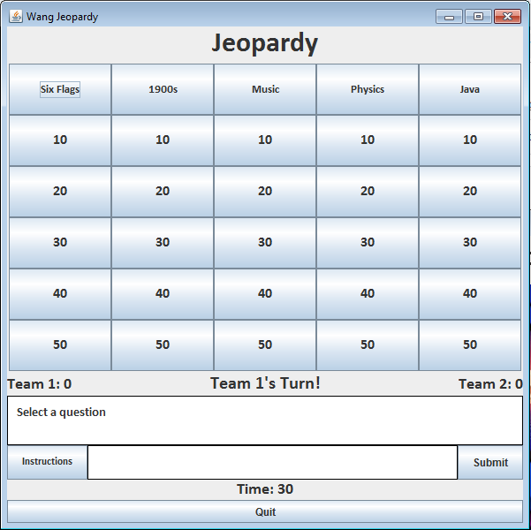
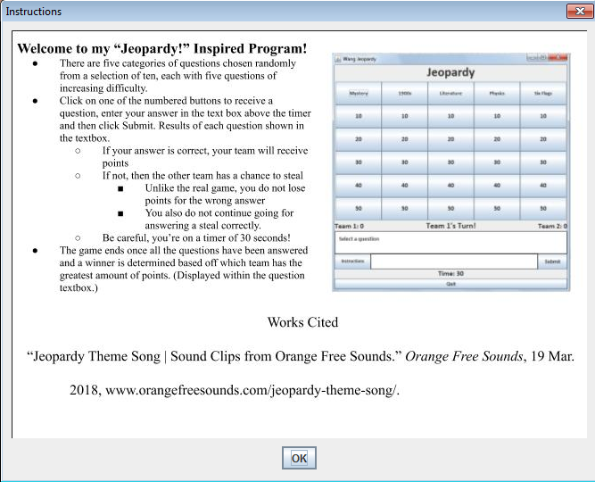
Graphical User Interface (GUI)

Slide 4
Game
Displays team scores and turn
Instructions
Mainly comprised of buttons
Thirty second timer

Slide 5
Summary
Title Class
JeopardyGUI Class
Category Class

Slide 6
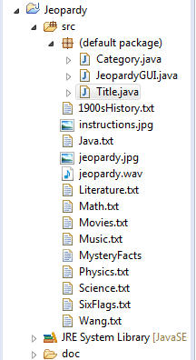
Methods and Programming
Text files
Category object
JeopardyGUI
Title

Slide 7
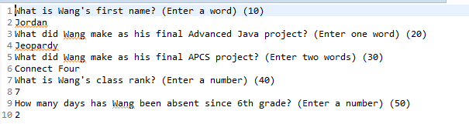
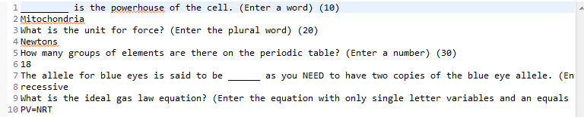
Text Files
10 lines of text
Questions and answers
Wang.txt
Science.txt

Slide 8
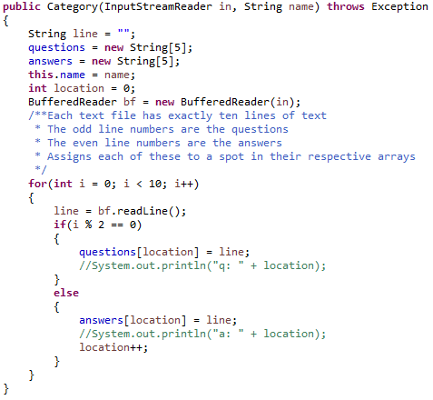
Category Object
Takes names of texts as input
Sorts questions and answers
Methods
getName()
getQuestions()
getAnswers()
Category

Slide 9
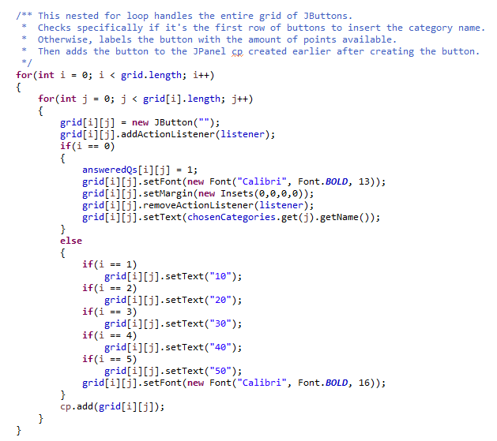
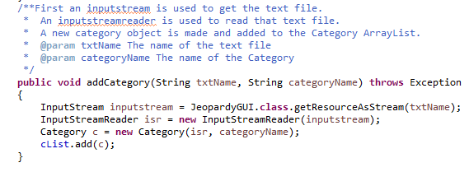
Jeopardy Interface
Button Grid Creator
Grid of buttons, textareas, labels, and timer
Placed and bound in panels
Creates categories, five categories chosen randomly
Category Creators

Slide 10
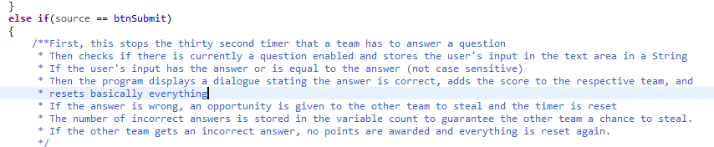
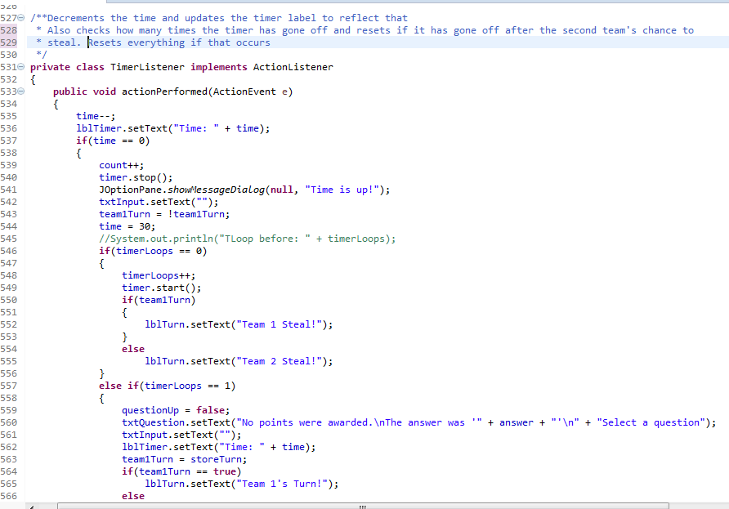
Submit
Timer

Slide 11
Timer

Slide 12
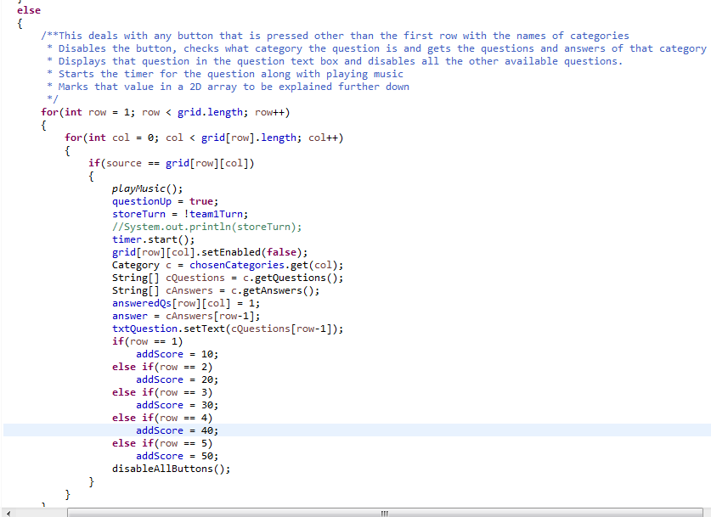
Button Grid

Slide 13
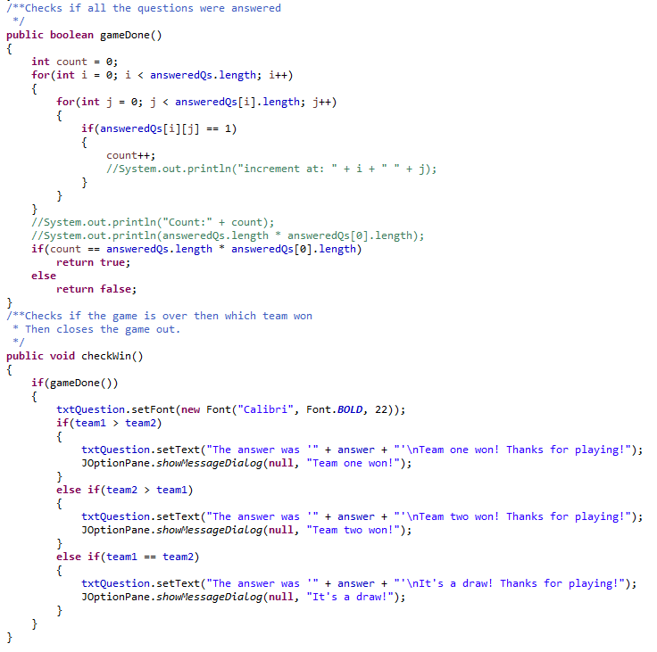
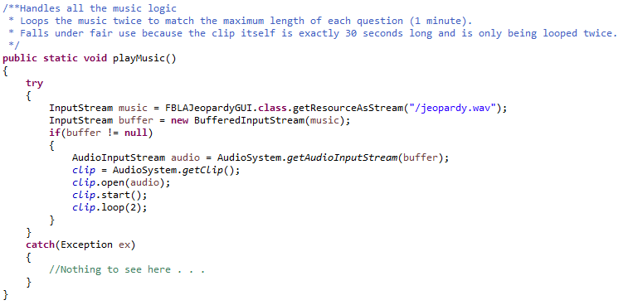
End Game
Music

Slide 14
Title Screen
Introduce the users to the game
Simple layout

Slide 15


